Slide 1
EXERCISE 2

Slide 2
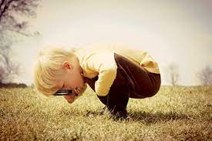
1
Curious: tò mò
/ˈkjʊə.ri.əs/
I have a very curious younger brother

Slide 3

2
Distance: khoảng cách
/ˈdɪs.təns/
The distance from my house to my friend's house is very short

Slide 4
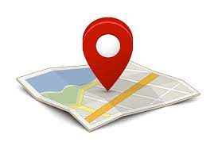
3
Site: địa điểm
/saɪt/
There are two restaurants on site

Slide 5

4
Alternative: thay thế
/ɒlˈtɜː.nə.tɪv/
There must be an alternative to people sleeping on the streets.

Slide 6
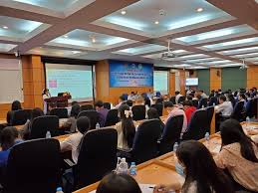
5
Ubiquitous: phổ cập, phổ biến
/juːˈbɪk.wɪ.təs/
Essentials are all the rage in fashion this season, as is the ubiquitous denim.

Slide 7
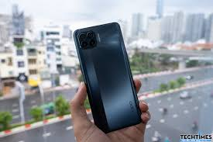
6
Features: tính năng, đặc năng
/ˈfiː.tʃər/
The phone has a lot of useful features for people

Slide 8

7
Enhance: nâng cao
/ɪnˈhɑːns/
It's things like this that enhance the quality of life.

Slide 9

8
Simplify: đơn giản hóa
/ˈsɪm.plɪ.faɪ/
The new simplified tax system looks pretty cool

Slide 10
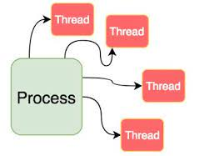
9
Process: tiến trình
/ˈprəʊ.ses/
the process of assembling my model is very difficult

Slide 11

10
Helpfulness: sự giúp đỡ
/ˈhelp.fəl.nəs/
I should emphasize the helpfulness of sharing problems and asking difficult questions.

Slide 12

11
Trustworthy: đáng tin cậy
/ˈtrʌstˌwɜː.ði/
Not even a newspaper always gives trustworthy information.

Slide 13

12
Personalized: cá nhân hóa
/ˈpɜː.sən.əl.aɪz/
His car has a personalized number plate

Slide 14

13
Benchmark: điểm chuẩn
/ˈbentʃ.mɑːk/
teachers give benchmark tests to see if students have grasped the new curriculum.

